Slide 1
Welcome to CSE 142!
Ana Jojic
Summer 2022
We’re so excited you’re here!

Slide 2
Agenda
About us
What is Computer Science?
About this course
Learning objectives
Other similar courses
Course components
Our learning model
Tools and resources
Course Website
Ed
Assessment and grading
Collaboration
(Fri)

Slide 3
Agenda
About us
What is Computer Science?
About this course
Learning objectives
Other similar courses
Course components
Our learning model
Tools and resources
Course Website
Ed
Assessment and grading
Collaboration
(Fri)

Slide 4
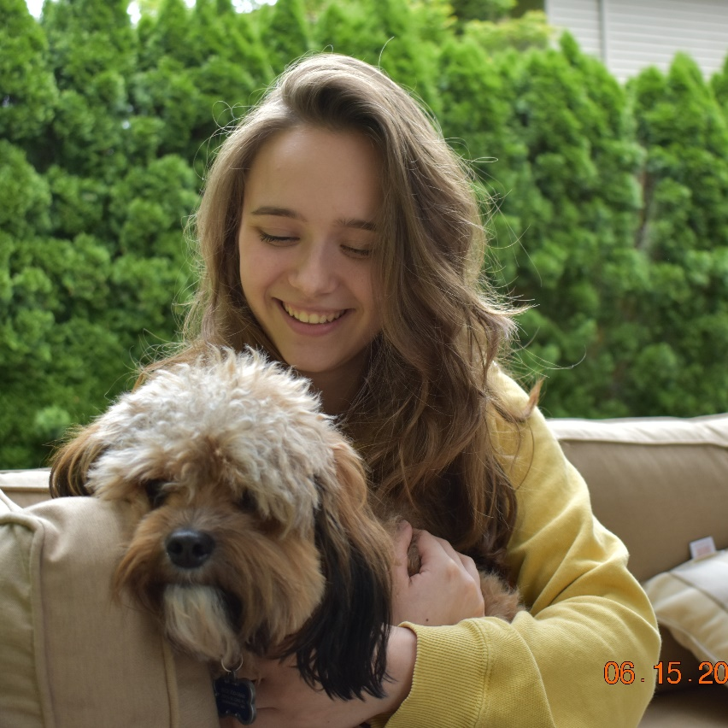
Hi, I’m Ana! (she/her)
Instructional Lecturer
B.S. in Computer Science and minor in Mathematics from UW
Research in biocomputing and computer vision
Previously…
Frequent TA and Head TA for CSE 142
Substituted for CSE 142 lectures
This is not my dog
This is my cat
Notes:
* I have the best cat in the world (her name is Cream but we call her Metz)
* I love music, dance, and theater
* My favorite courses at UW have all been philosophy courses
* I majored in Computer Science with a minor in Mathematics
* I did research in a biocomputing lab working with DNA and research in computer vision working on land cover mapping of satellite images
* All of this to say I have many interests but my absolute favorite experience as an undergraduate student has been TAing for CSE 142 (started in Fall 2018)

Slide 5
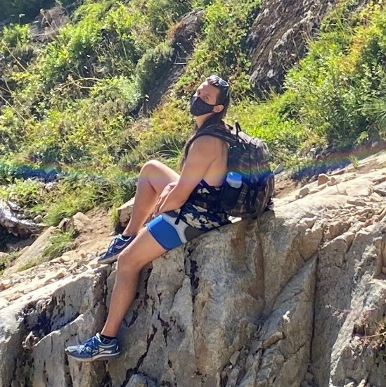
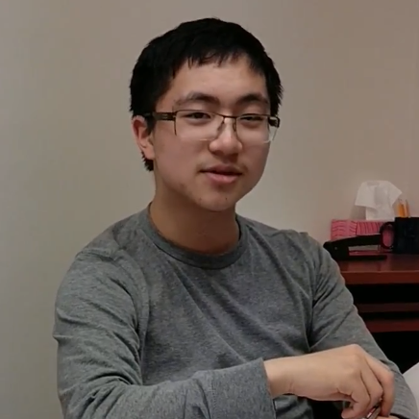
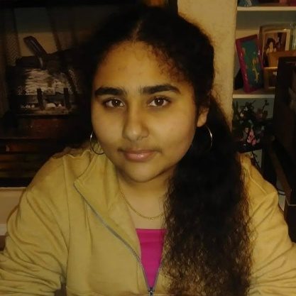
Meet your TAs
Notes:
* Passionate about TAing and the power that we have as young people and students to teach and learn from each other
* We all have worked in 142 before and we care about your learning!!
* Our goal is to show you that you are capable of learning how to interact with a computer to write programs that do all sorts of cool things

Slide 6
Agenda
About us
What is Computer Science?
About this course
Learning objectives
Other similar courses
Course components
Our learning model
Tools and resources
Course Website
Ed
PollEverywhere
Discord
Assessment and grading
Collaboration
(Fri)

Slide 7
What is Computer Science?
Algorithm:
a step-by-step procedure for solving a problem or accomplishing some end especially by a computer
Programming is like
a building block
Computers?
Algorithmic Thinking
Science?
Notes:
* Many applications in various fields as a tool (maybe an engineering kind of thing as well as a science
* One core component common across computer science is the idea of “algorithmic thinking”
* Algorithm is not a computer-specific term necessarily – you can describe an algorithm (a step by step procedure) for anything: (putting on shoes even if you don’t put shoes on that still describes your process; science experiments with protocols; recipes for baking
* Programming is the process of taking an algorithm and translating it into a language that the computer can understand
* Programming languages describe certain syntax that allows us to interact with the computer and tell it what to do (we are going to learn the syntax for the Java language)
* Programming is a tool we use in computer science, and will be the main focus of our introductory class

Slide 8
Agenda
About us
What is Computer Science?
About this course
Learning objectives
Other similar courses
Course components
Our learning model
Tools and resources
Course Website
Ed
Assessment and grading
Collaboration
(Fri)

Slide 9
Learning Objectives
or, “What will I learn in this class?”
Functionality/Behavior: Write functionally correct Java programs that meet a provided specification and/or solve a specified problem
Functional Decomposition: Break down problems into subproblems that are modular and reusable, and define methods to represent those subproblems
Control Structures: Select and apply control structures (e.g. methods, loops, conditionals) to manage the flow of control and information in programs
Data Abstraction: Select and apply basic data abstractions (e.g. variables, parameters, arrays, classes) to manage and manipulate data in programs
Code Quality: Define programs that are well-written, readable, maintainable, and conform to established standards
Notes:
* 1 out of the 5 is related to behavior (what the program does) – we are interested in writing programs that successfully do the task they are supposed to
* However the code we write is not just for the computer to execute! * Other people have to look at the code we write and be able to use it and understand it (not only for grading – in the real world, people look at the code other people write so they can use it for their own purposes)
* In order to improve ease of communication, we as programmers do our best to write code that is easy to understand by employing a set of common design principles and documentation/readability standards so that anyone reading a Java program can more easily identify and understand what is happening in the code
Design principles relating to functional decomposition of the problem, use of control structures to manage information flow, and data abstraction
Documentation of our code so that the high-level details can be read without look at the details of the code
Adhering to readability standards that make the complicated syntax of a complex program easier to parse (read/visually understand)

Slide 10
Other Similar Courses
Course | Good choice if…
CSE 142 | You’ve never programmed before OR You’ve done a little programming but feel rusty or not confident AND You are, or want to be, in major (or looking to take classes) such as CS, CE, EE, Info, etc. that requires Java programming
CSE 143 | You’ve programming in Java before OR You took AP CS A or IB CS in high school
CSE 160 | You’ve never programmed before AND You’re interested in data science and analysis OR You’d rather learn Python than Java* OR You are, or want to be, in a major such as Physics, Bio, Stat, etc. where analyzing data through programming is useful

Slide 11
Course Components
Lessons (aka Lectures)
Sections
MWF, 12:00pm PDT
Held live in person; recordings released after
First introductions to course concepts
Mix of presentation of content and practice activities/problems
Some required pre-work
Th, various times
Led by TAs
Held live in person; not recorded
Short videos will be released on occasion when important material is covered
Additional review, discussion, and practice
Mostly practice problems
Attendance is not taken, but you are responsible for all material (including announcements).
Notes:
Prework typically meaning you have watched the previous lectures – occasionally due to the compressed nature of summer quarter (9 weeks to cover what is typically taught in 10 and also we are missing 2 lectures due to holidays) will also provide shorter videos that cover material we may have had to skip in lecture or videos that go over the material at a slower pace
Recommendation for lecture: sit back and absorb (take quick notes if you want, but don’t try to code along live because you’ll likely miss some important things) and ask questions if you get stuck or confused so you can try to soak in as much new info as possible to practice later
Section is the thing TAs usually look forward to the most and they do their best to make sections helpful for you, so please come ☺
Section is where you will get practice with coding with a TA there to help you along (good to bring a computer to section so you can follow along)

Slide 12
Course Components
Labs (optional)
T, various times
Problems released online, support from TAs in person
CSE 190 sections X and Y (pending open registration)
1 credit course
Credit/No Credit grading
Notes:
Registration will be open shortly if it isn’t already
You can email course admin cse142@uw.edu for late registration for labs if there are issues with late adds

Slide 13
Agenda
About us
What is Computer Science?
About this course
Learning objectives
Other similar courses
Course components
Our learning model
Tools and resources
Course Website
Ed
Assessment and grading
Collaboration
(Fri)

Slide 14
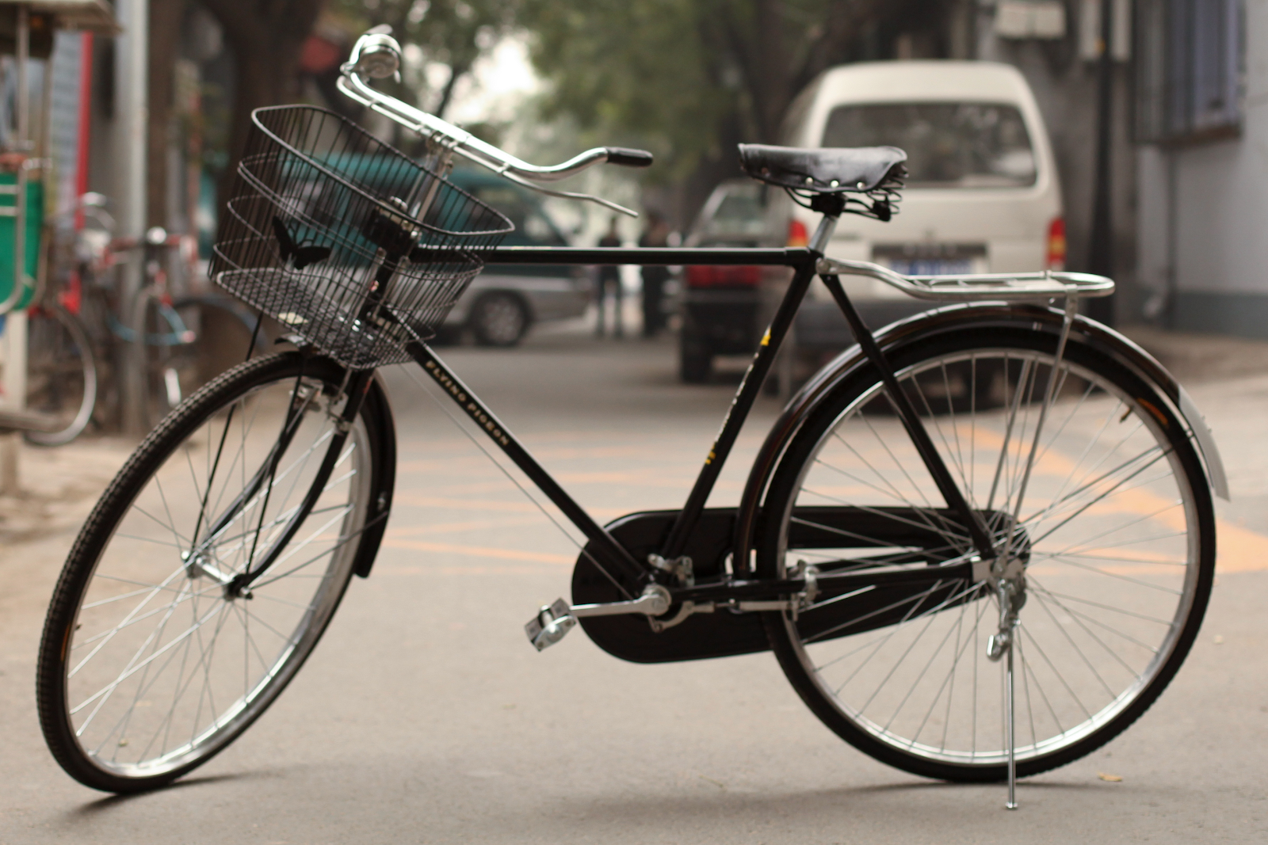
Notes:
Did you learn to ride a bike by watching someone else ride a bike?
Did you learn to ride a bike by trying yourself, falling sometimes, trying to figure out the balance, etc.?
Need to learn to code by practicing coding → we offer tons of guided examples in lectures but you should also try out the sample problems we offer and try to code things up yourself to get practice doing the thing so you can learn
Not everything will sink in as I’m first explaining things (though I will try my best to explain things in a manner that is easy to follow)

Slide 15
Learning in CSE 142 (or anywhere)
Notes:
Exposure in lecture, videos, textbook readings, slide resources
Guided practice with lecture activities, sections, and labs
Independent and group practice with checkpoints (shorter assessments that give you some practice with new material), section problems, and additional practice problems that are offered accompanying each lecture
Assessments: demonstrate mastery so far and receive feedback to continue improving and learning

Slide 16
Agenda
About us
What is Computer Science?
About this course
Learning objectives
Other similar courses
Course components
Our learning model
Tools and resources
Course Website
Ed
Assessment and grading
Collaboration
(Fri)

Slide 17
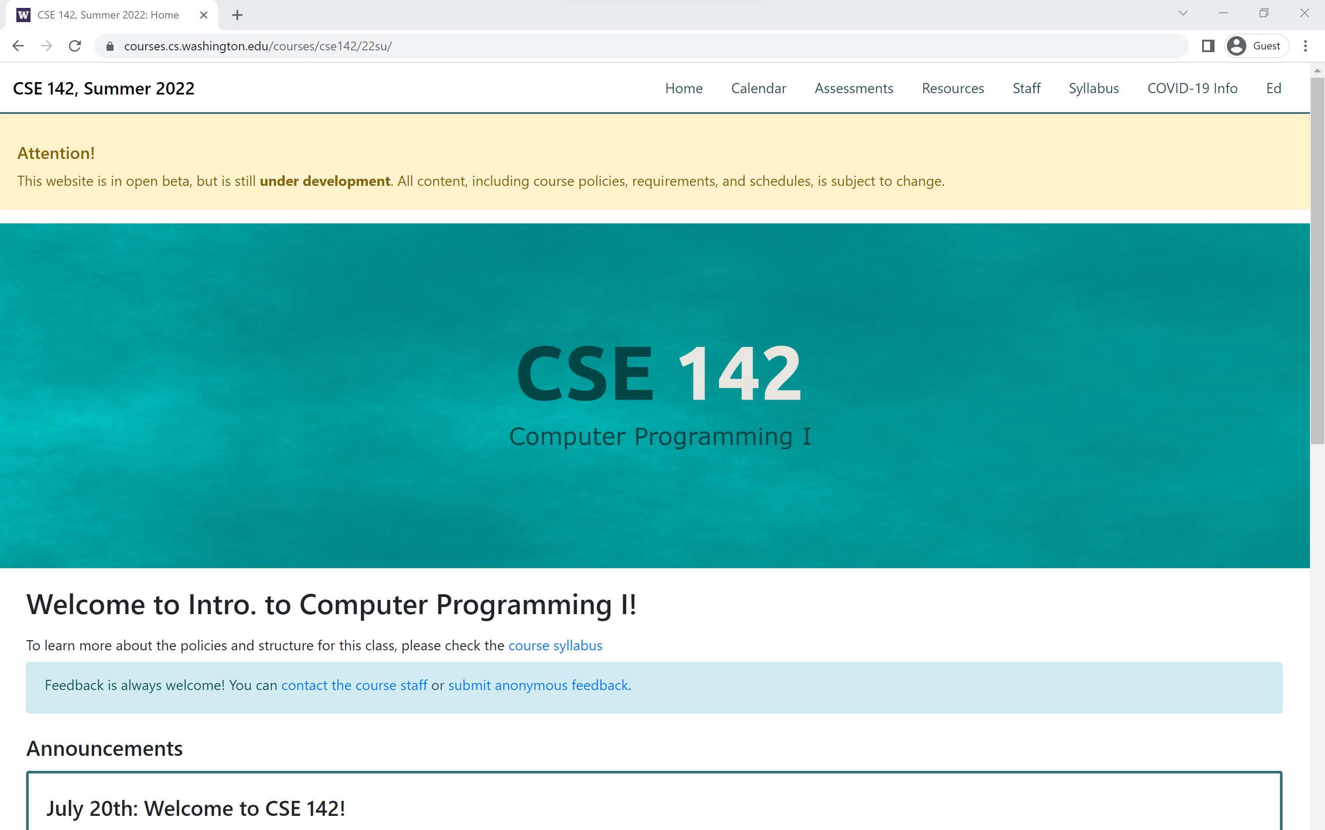
Course Website
cs.uw.edu/142
Primary source of course information (not Canvas)
Calendar will contain links to (almost) all resources
Notes:
Calendar with links to Ed for each day
Assessments tab where resources/info on all graded work can be found (THAs, * checkpoints, culminating assessments, and resubs)
Resources tab with links for software, staff emails, support hours, message board, code quality guide
Syllabus with ALL the info on the course structure

Slide 18
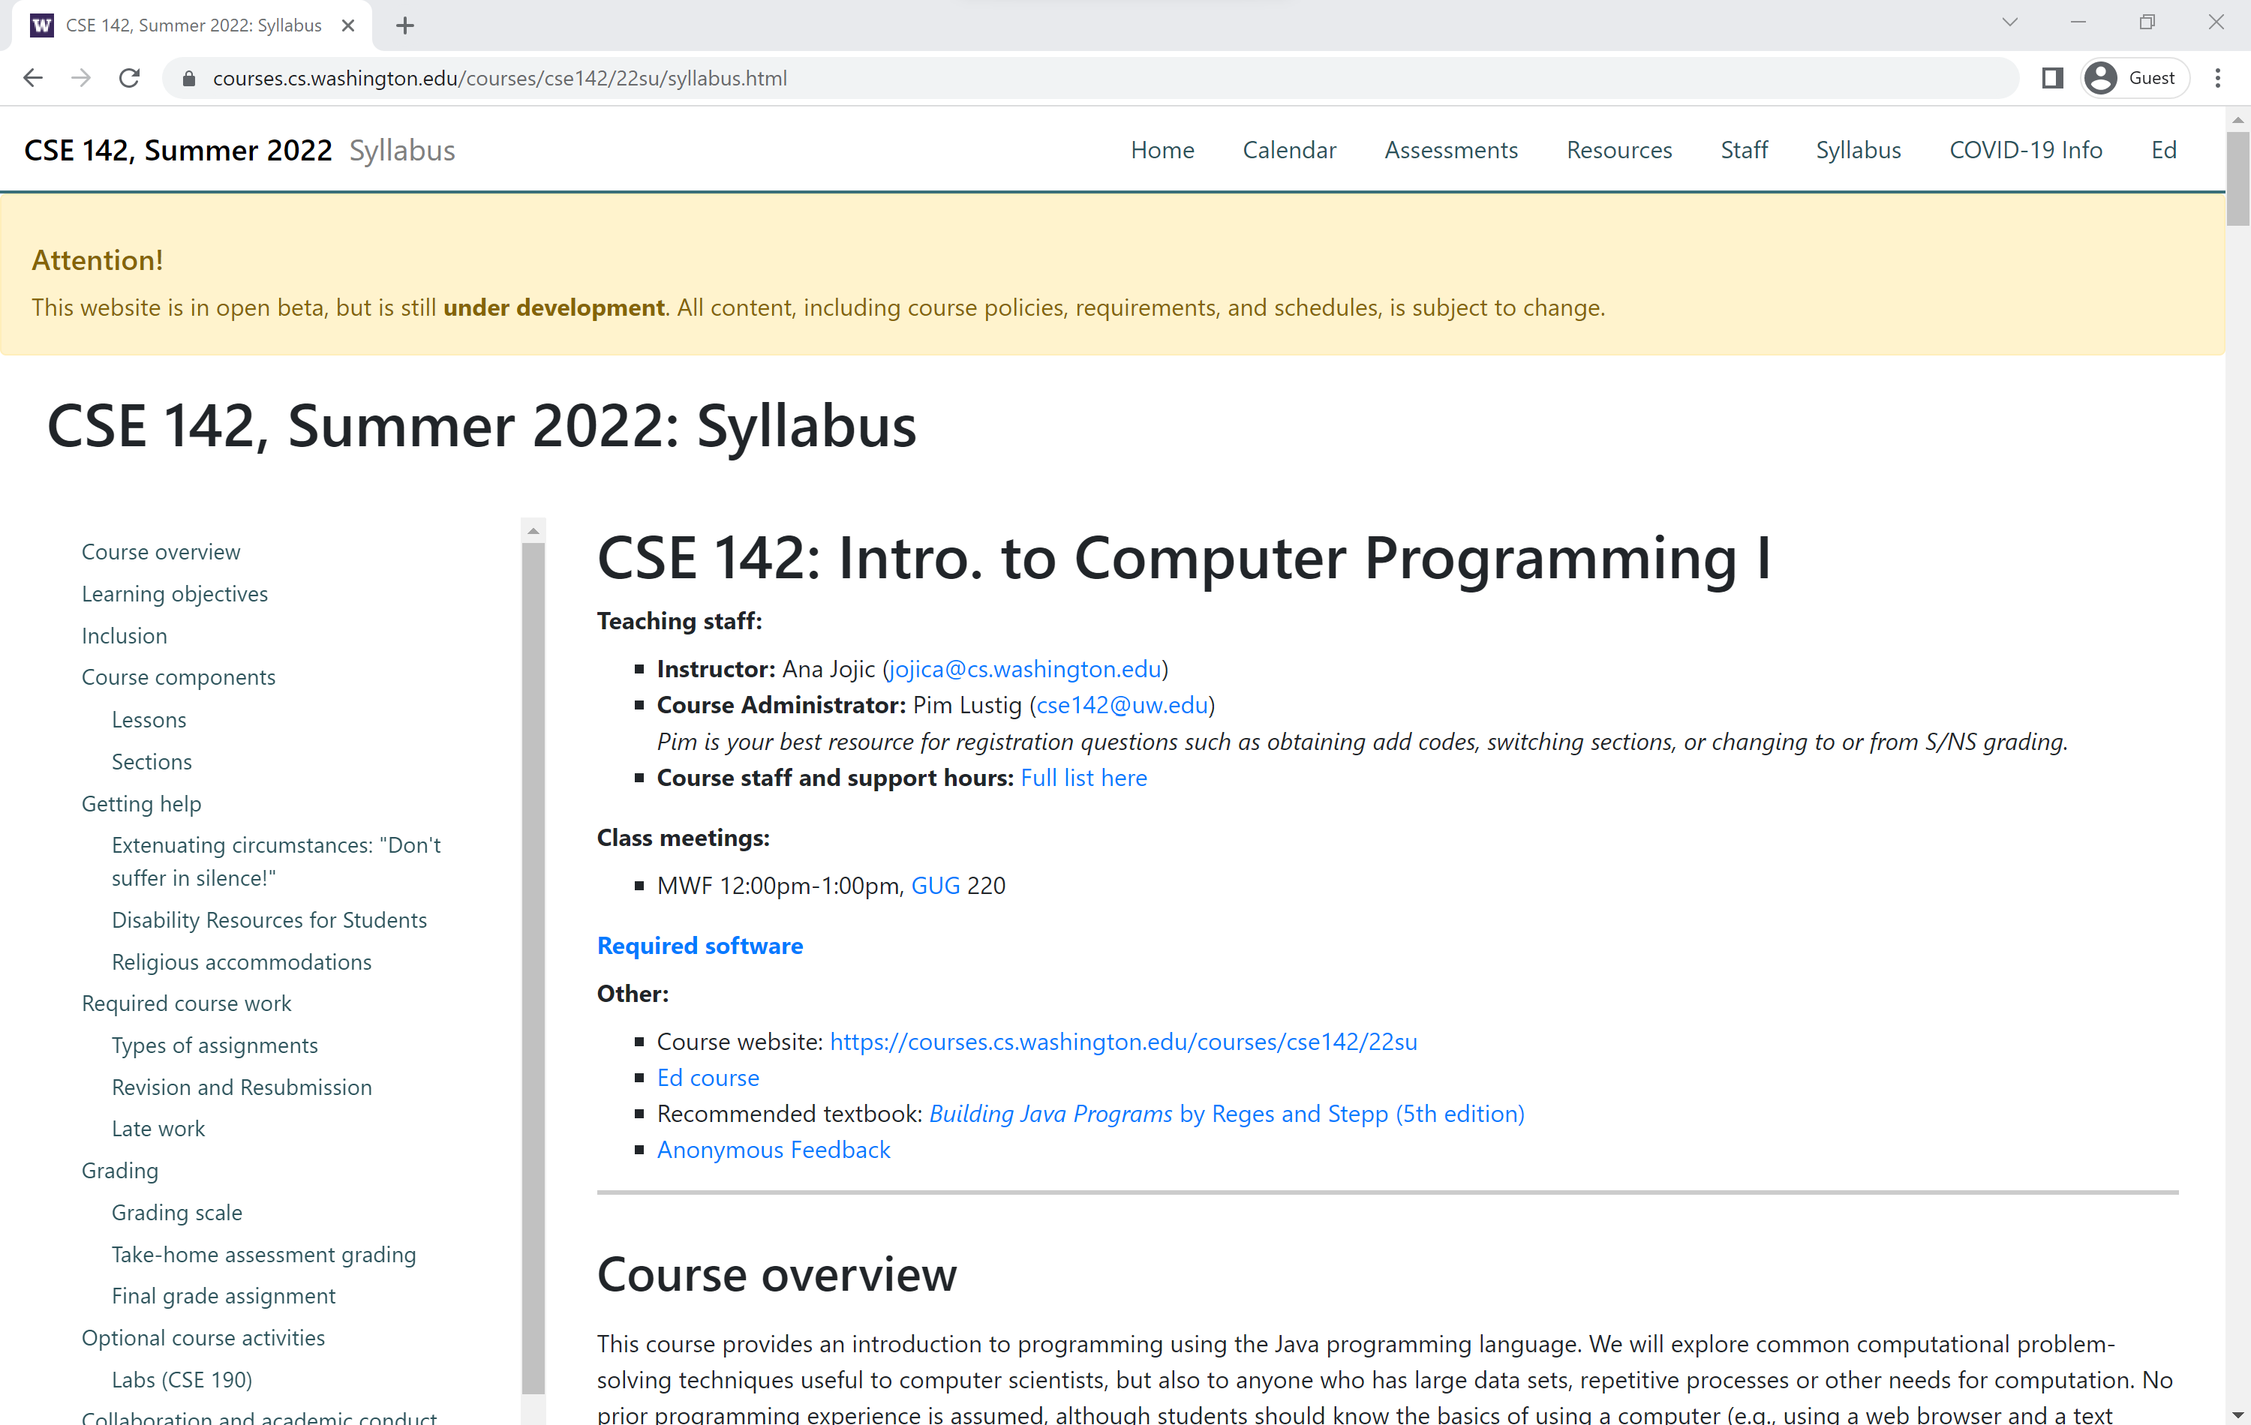
Course Website
Please review the syllabus ASAP.
Notes:
* Try to read through all of it by the end of the week because there will be questions on the first checkpoint relating to it (you can refer back to the syllabus when answering the questions)

Slide 19
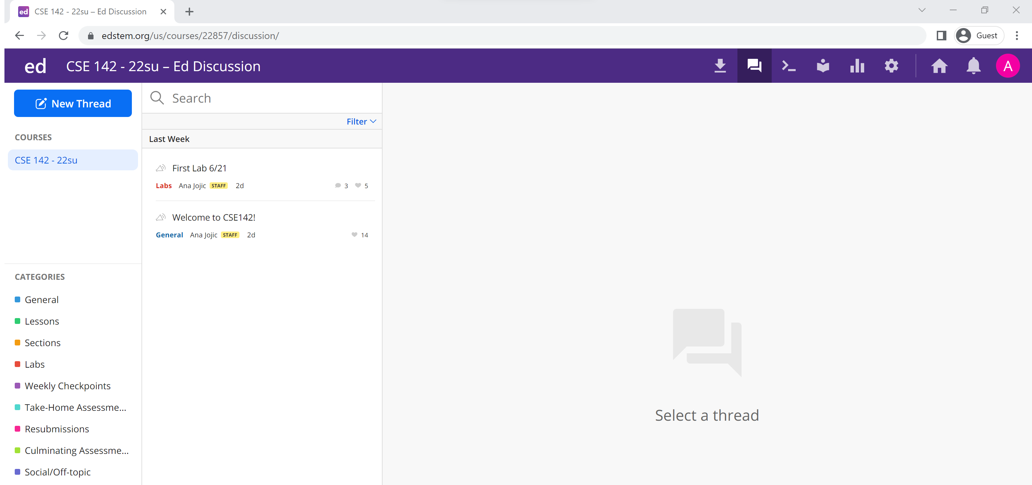
Ed
Our online learning platform
Lessons, sections, labs, assessments all here
Lecture Megathreads for each day that will be monitored by TAs during lecture
Intro and walkthrough video forthcoming
Notes:
Discussion tab for course message board
Announcements (assessment/feedback release, supplemental content)
Clarifying questions about lecture/section/lab/spec
Megathread for lecture questions (also live stream link, which is also available through Panopto folder on Canvas)
Private questions about assessment code
Lessons tab for lecture, section, lab, and assessment content (all links on the course website as well)

Slide 20
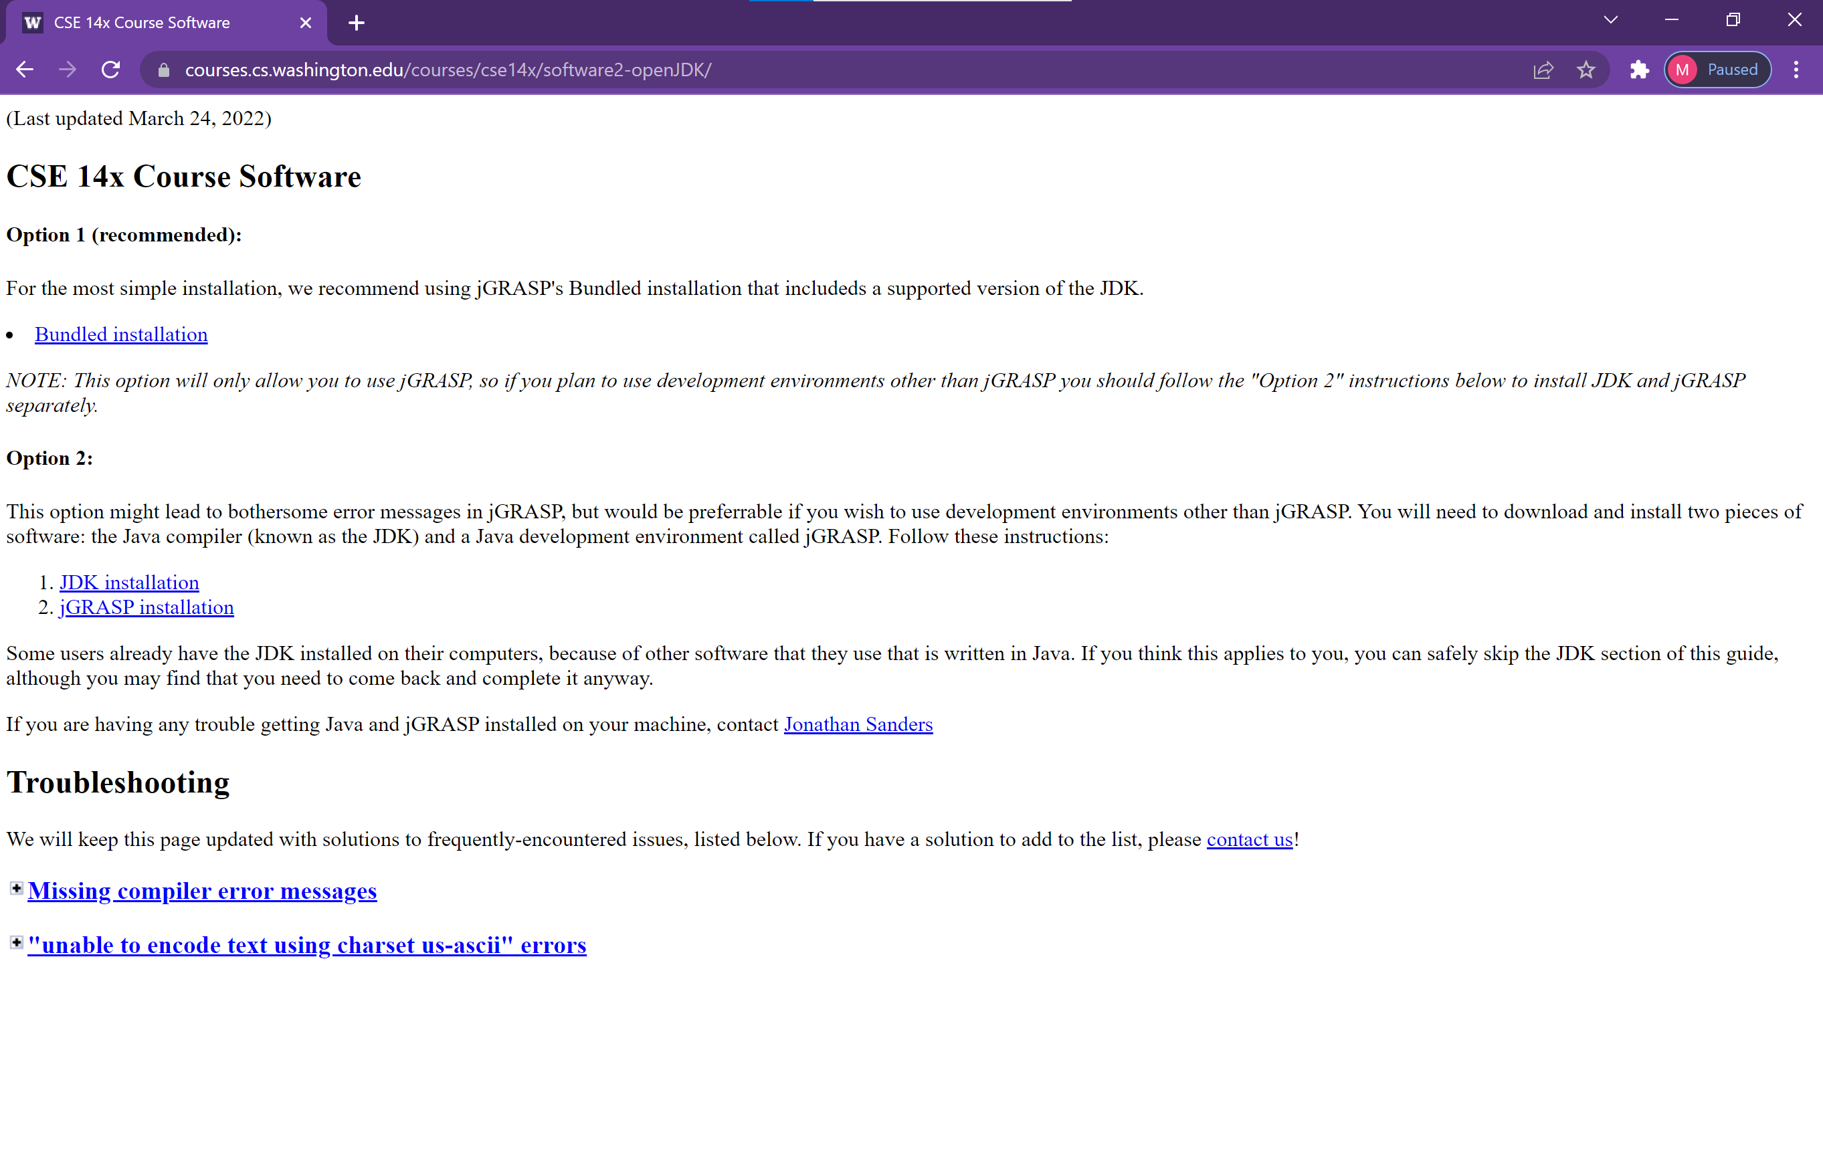
Software
You will need to install the JDK and jGRASP
Notes:
JDK stands for Java Development Kit (you need Java installed on your computer to be able to write in Java)
jGRASP is an IDE (Integrated Development Environment) aka a text editor for code where you can also run the programs
Can use whatever IDE you want, but we recommend jGRASP for beginners because it’s relatively simple but still has a lot of nice features

Slide 21
Agenda
About us
What is Computer Science?
About this course
Learning objectives
Other similar courses
Course components
Our learning model
Tools and resources
Course Website
Ed
Assessment and grading
Collaboration

Slide 22
Assessment and Grading
Our goal in the course is for you to master the concepts and skills we teach
We assess your mastery by asking you to apply the concepts and skills on tasks or problems
By necessity, we are assessing your work as a proxy for your mastery
Your final grade should reflect the extent to which you have demonstrated mastery of the course objectives

Slide 23
Assessment
Your learning in this course will be assessed in four ways:
Checkpoints (~weekly)
Short quiz on upcoming assessment specification
Short problems to help you practice and make sure you’ve got the basics for the week
Take-home assessments (~weekly)
Large programming assignments to assess your full mastery of that week’s concepts (plus some previous material)
Culminating assessments (2/quarter)
Series of problems covering all material up to that point
Reflections (w/other assignments)
Written assignments to help you think critically about your learning and progress
Notes:
Checkpoint 1 and Take Home Assessment 1 are released today (Wednesday)
CPs due Saturdays 11:59pm – CP1 about syllabus, THA1 spec, and short coding problem ~ coding problem we will finish covering the material needed on Friday
THAs usually due Tuesdays 11:59pm the following week after released, but THA1 will be due next Wednesday since today is our first day of lecture
Reflection will be a file accompanying each THA submission
More about grading on Friday, but you can get started on both as soon as today ☺

Slide 24
Resubmission
Learning takes time, and doesn’t always happen on the first try
One previous take-home assessment can be resubmitted each week
Must be accompanied by a write-up describing changes
Grade on resubmission will replace original grade
See the syllabus for more details
Notes:
Motivation -- first time showing mastery is when you're still learning and we provide feedback to help you improve in subsequent work
By the time A7 comes around, maybe you have a great grasp on methods, but you didn't when we first assessed you in A1
Things are cumulative, so the things from before continue to matter and be worked on
We'd like you to be able to show mastery after having more time and processing the feedback you receive from TA (show improvement after more time working with the material)
Staffing limitations mean we can accommodate 1 resubmitted assessment per student per week
Generally enough resubmissions to do one per assessment
Strategy: start early, break program down, and do as much as you can, and submit initially so you can get feedback from your TA on what you have so far
Late work
Generally late work for THAs are not accepted, but email if you have DRS accommodations or extenuating circumstances
For checkpoints, can fill out late checkpoint token form – will have to find an article about a current CS topic or issue and write a description of the main points you found compelling

Slide 25
Grading
Grades should reflect your mastery of the course objectives
Checkpoints, culminating assessments, and reflections are graded S (Satisfactory) or N (Not Yet)
If you submit on time and meet all requirements, you’ll get an S
Take-home assessments will be grade E (Exemplary), S (Satisfactory), N (Not yet), or U (Unassessable) on four dimensions:
Behavior
Structure & Design
Use of Language Features
Code Quality
Final grades will be assigned based on the amount of work at each level
See the syllabus for more details
Notes:
Final grade guarantees on syllabus
Additive, get credit for the work you show
NOT starting at 100% and losing points --> you don't have an estimated grade at any given point because you haven't done all the work to assess the final grade
Minimum Grade Estimator sheet linked on Ed to keep track of what grade guarantees you have successfully met so far
CPs grade S/N on getting a green checkmark on all slides
Reflections S/N answering the questions
Take-Home assessments general criteria on syllabus
4 dimensions --> 4 separate grades for each THA (behavior, structure and design, use of language features, documentation/readability) which cover our 5 learning objectives (control features and data abstraction are largely covered by UOLF)
Behavior can be checked by the tests on Ed
Code Quality Guide has information on documentation and readability as well as many UOLF issues
Rest of UOLF and SD are covered in class when we talk about design principles
Feedback will be given explaining what parts of the code don't align with the design principles/documentation and readability standards
Talk more about understanding grades when feedback is out

Slide 26
Agenda
About us
What is Computer Science?
About this course
Learning objectives
Other similar courses
Course components
Our learning model
Tools and resources
Course Website
Ed
PollEverywhere
Discord
Assessment and grading
Collaboration

Slide 27
Collaboration Policy
Learning is hard, but it’s easier when you learn from each other
You are encouraged to form study groups, work together on practice and review, and discuss your ideas and approaches at a high level
If you discuss your ideas with others, you must cite them
All work you submit for grading must be your own
Any work found to not be your own will receive a grade of U and may not be resubmitted
If it’s not your work, we can’t assess your mastery from it
See the syllabus for more details

Slide 28
Amnesty
Sometimes, we make bad choices that we regret
“If you submit work that is in violation of the academic conduct policy, you bring the action to Ana’s attention within 72 hours of submission and request amnesty. If you do so, you will receive a grade of U for the initial submission, but you will be allowed to resubmit your work under the normal resubmission process.”
See the syllabus for more details

